Slide 1

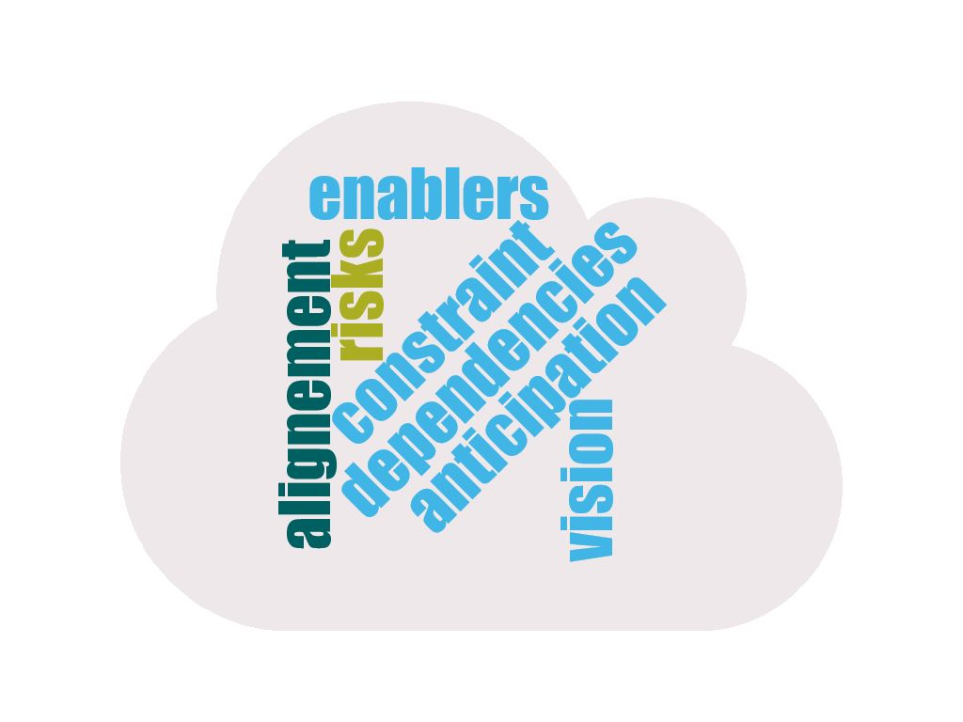




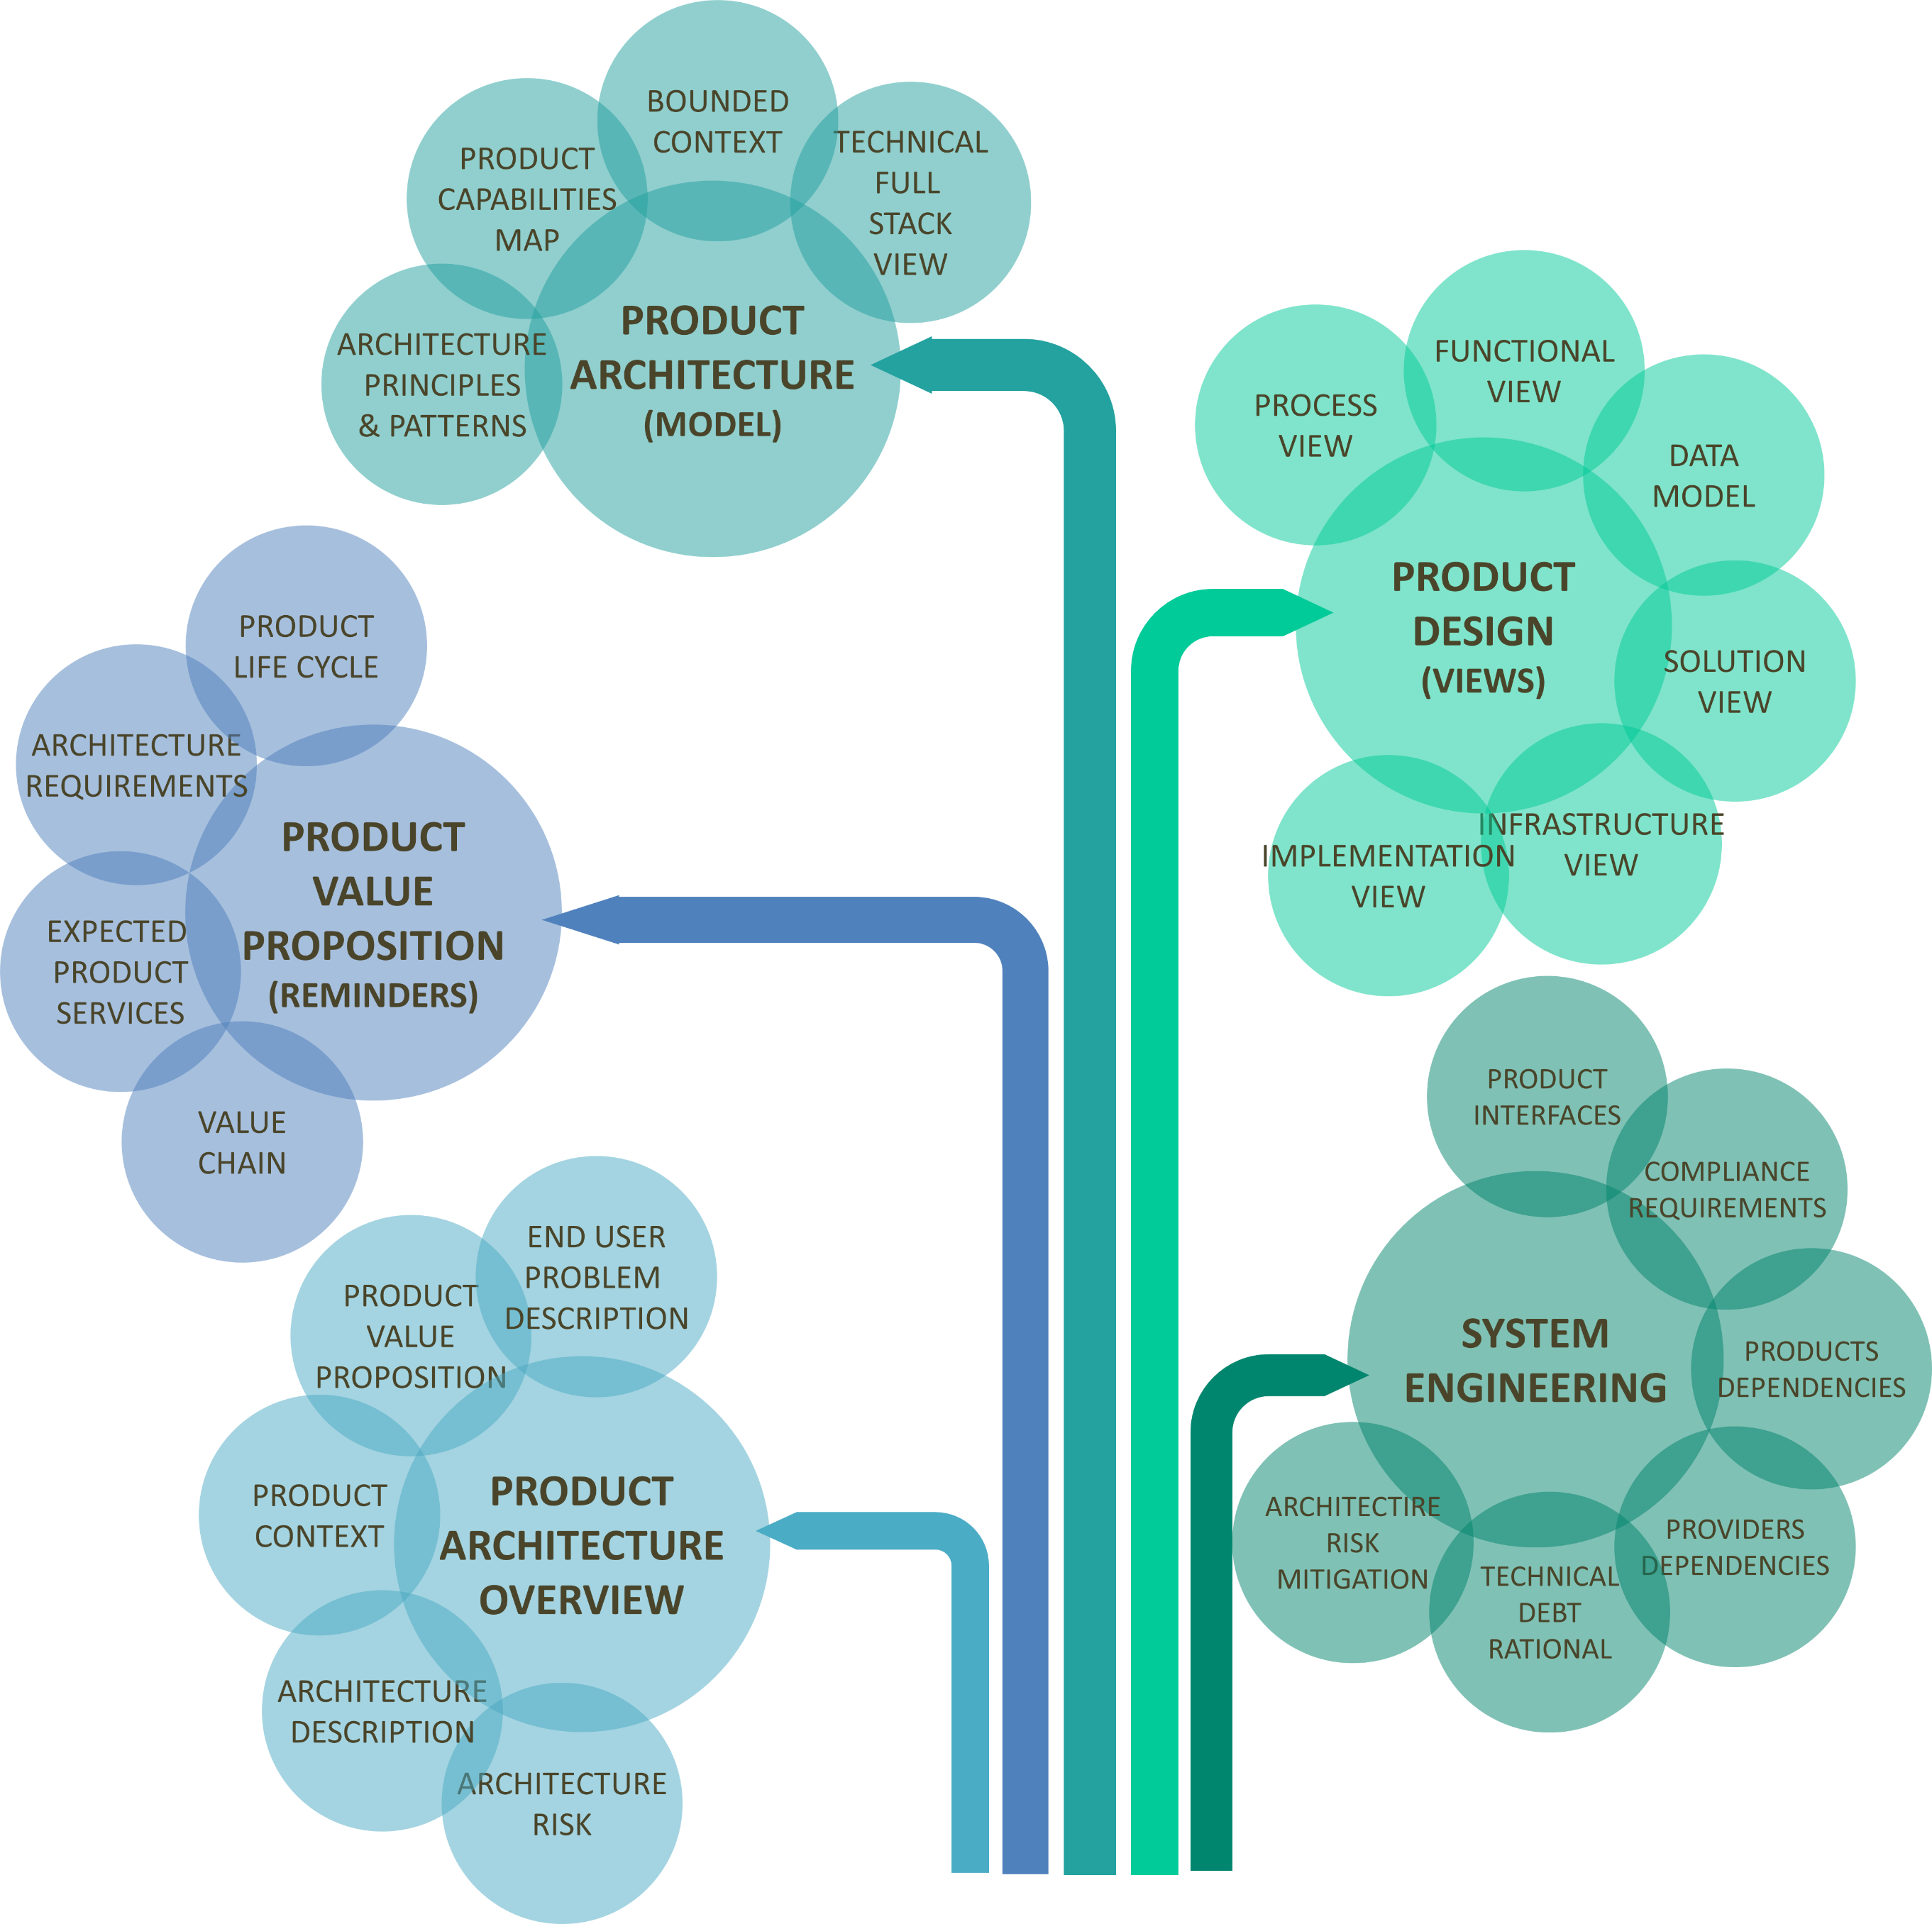
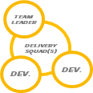




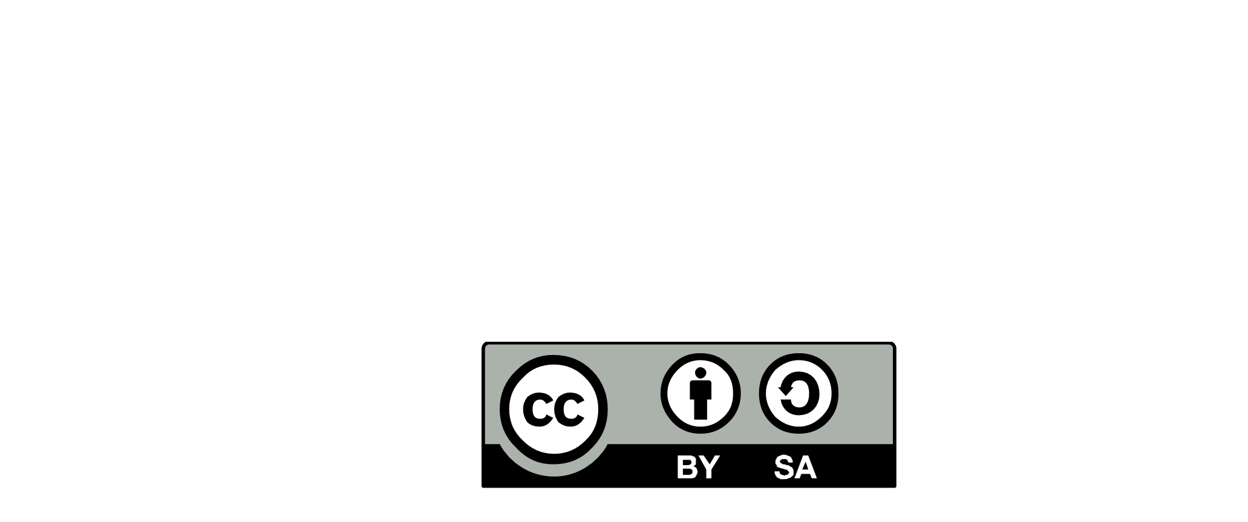

ARCHITECTURE WORKSHOP (SCOPING 360°)
3 * 1 day
SUGGESTED OUTCOMES
GLOBAL SHARING AND UNDERSTANDING
Share architecture drivers and assumptions
Draft architecture design
Identify main architecture issues
(functional and technic)
BUSINESS/PRODUCT
(SCOPING 360°)
FACILITATION
BUSINESS
AMBITIONS
NON FUNCTIONAL
REQUIREMENTS (INPUTS)
ARCHITECTURE DELIVERABLES (INITIATE)
PRODUCT
OWNER
INTERNAL
EXPERTS
PHYSICAL
ARCHITECTURE
DIAGRAM
ENTERPRISE/IT
(INTENTIONAL)
DOMAIN
DRIVEN
DESIGN
ARCHI
ARCHIMATE
IT STRATEGY
PRINCIPLES
BLUEPRINTS
EXTERNAL
EXPERTS
ARCHTECTURE
REQUIREMENTS
GREEN
PATTERNS
GUIDELINES
PRODUCT
TECH
RADAR
SYSTEM ENGINEERING
(END TO END)
VALUE
CHAIN
ARCHI
MEGA
APPLICATION
PORTFOLIO
ARCHITECTURE
MODELS
ARCHIMATE
GUEST(s)
BUSINESS / PRODUCT
INTENTIONAL
PROVIDERS
POSSIBLE SOLUTIONS
BUSINESS
SPONSOR
END
USER
MARKETING
ARCHTECTURE
TECHNOLOGY
KNOWLEDGE
(RADAR)
IT COMPONENT
CATALOGUE
IT PLATFORMS
SYSTEM ENGINEERING (other teams)
ARCHITECTURE BOARD (INITIATE)
ARCHITECTURE
RUNWAY
FITNESS
FUNCTION
GITLAB
DECISION
LOG
TOOLSET
LOCAL
TECHNICAL
DEBT
SUGGESTED WAY OF WORKING
ANTICIPATE (RUN)
Wallpaper + post it
Architecture toolbox
FUNCTIONAL
ISSUE
Conversation
Sketches on walls
Collective production
OPS
TECHNICAL
ISSUE
ARCHITECTURE ROLE &
RESPONSABILITIES
(i.e. Organization workshop)
ARCHITECTURE RUNWAY
DOMAIN
DRIVEN
DESIGN
EVENT
STORMING
Kit
Kit
Kit
ARCHIMATE
Kit
ARCHITECTURE RITUALS
-2020.2 -

